Slide 1
Lung Cancer Analysis with Machine Learning
Notes:
It’s my to be presenting our analysis on Lung Cancer as our group project.

Slide 2



Objectives of our Presentation
1
2
3
Raise awareness of
lung cancer in
Singapore’s context
Use machine learning models to predict
the chances of developing lung cancer
Educate on the actions that one can take in preventing lung cancer
and support avenues
Introduction | Key Determinants | Machine Learning | Prevention & Treatment | Conclusion
Notes:
The objectives of the presentation is to raise awareness of lung cancer within Singapore’s context, use machine learning models to predict chances of developing lung cancer and educate on actions that one can take to prevent lung cancer.

Slide 3




Presentation Outline
Introduction to
Lung Cancer
Understanding what is lung cancer
Lung cancer trends and future outlook in Singapore
Key Determinants & Symptoms
Key determinants of lung cancer (i.e. lifestyle choices, biological factors)
Common symptoms of lung cancer
Machine Learning Model
Showcase of different machine learning models used
Our evaluation methodology for model selection
Results from analysis
Prevention
Methods
The significance of early detection
Steps that can be taken to prevent lung cancer
Avenues to seek assistance
Introduction | Key Determinants | Machine Learning | Prevention Methods | Conclusion
Notes:
This our presentation outline: We’ll start off with a brief introduction, followed by key determinants and machine learning models, and we’ll end it off with preventions methods

Slide 4

What is Lung Cancer?
Lung Cancer:
The growth of abnormal cells (tumours) in the lungs that interfere with respiratory functions. These cells can soon spread to and harm other organs
Non-Small Cell
Lung Cancer
Small Cell
Lung Cancer
Accounts for almost 85% of all cases. The cells tend to grow
and spread at a slower rate
It’s a variant where the cells spread at a much more aggressive rate.
Introduction | Key Determinants | Machine Learning | Prevention Methods | Conclusion
Notes:
To begin, I would like to briefly explain What is Lung Cancer and why is it so important.
Lung cancer is a type of cancer in which the growth of abnormal cells in the lungs, or tumours, starts to develop and interfere with respiratory functions.
These abnormal cells soon spread to other parts of the lungs or even other organs. It can be categorised into two main types - Non-Small Cell Lung Cancer (NSCLC) and Small Cell Lung Cancer (SCLC). NSCLC makes up about 85% of cases, and it tends to grow and spread at a slower rate, while SCLC is more aggressive and spreads quickly¹.

Slide 5
Why should we care about lung cancer?
3rd Most Common Cancer Variant For Both Genders
Lung Cancer has the highest death toll for males while being the third deadliest for females.
Source: National Cancer Registry 2022
Introduction | Key Determinants | Machine Learning | Prevention Methods | Conclusion
Notes:
Lung Cancer remains one of the leading causes of cancer-related deaths globally². In Singapore, as seen in the figure on the left, lung cancer is the third most common cancer in both males and females. While also producing the highest death tolls in Singapore, as seen in Figure on the right. From 2018 to 2022, lung cancer was the cause of death of about 4000 males and also the cause of death of about 2000 females.

Slide 6
Lung cancer trends over the years
Metrics: Crude Incidence Rate (CIR), Crude Mortality Rate (CMR), Age-Standardised Survival Rates (ASRS)
Advances in treatment boost cancer survival, with rising age-standardized rates for both genders
Source: National Cancer Registry 2022
Introduction | Key Determinants | Machine Learning | Prevention Methods | Conclusion
Notes:
Moreover, as shown in figures here representing data for males on the left and females on the right, lung cancer has been on the rise in Singapore. The Crude Incidence Rate (CIR), the number of cancer incidences per 100,000 people, has risen for both genders.
Specifically, from 2003 to 2022, the CIR increased from 44.8 to 58.5 for males. For females, it increased from 21.8 to 34.4 across the same period. The Crude Mortality Rate (CMR), the number of cancer mortalities per 100,000 people, also increased but it has been plateauing for both genders.
This shows signs that there is reason to be optimistic for cancer survival due to the advancements in treatments like chemotherapy, targeted therapy, and immunotherapy⁹, which is shown by an increase in age-standardised survival rates for both genders (ASRS).
From 2003 to 2022, we observed an increasing trend in ASRS for males and a huge spike in up-trend in ASRS for females, rising from 13.9% to 37.8%. This gives stronger support for the identification and treatment of lung cancer given the promising results of improved survival rate, especially in the early stages.

Slide 7
Lung cancer will remain an important concern into the future
Source: World Health Organisation
Introduction | Key Determinants | Machine Learning | Prevention Methods | Conclusion
Notes:
Looking into the future, we can expect the historic trends to continue. Predictive analyses by the World Health Organisation forecasted a rise in the general trend in lung cancer incidences and mortality rates in Singapore from 2022 to 2035. As seen in the figure, the trend shows an approximate increase of in deaths from 2747 to 5425 and an increase in incidences from 2940 to 5353 .
NEXT we’ll run through on Key determinants and Symptoms of lung cancer

Slide 8



Key determinants of lung cancer
Smoking
Alcohol Consuming
Age
Introduction | Key Determinants | Machine Learning | Prevention Methods | Conclusion
Notes:
Moving on to the key determinants of lung cancer, we found that smoking, consuming alcohol and age were highly associated with lung cancer.

Slide 9
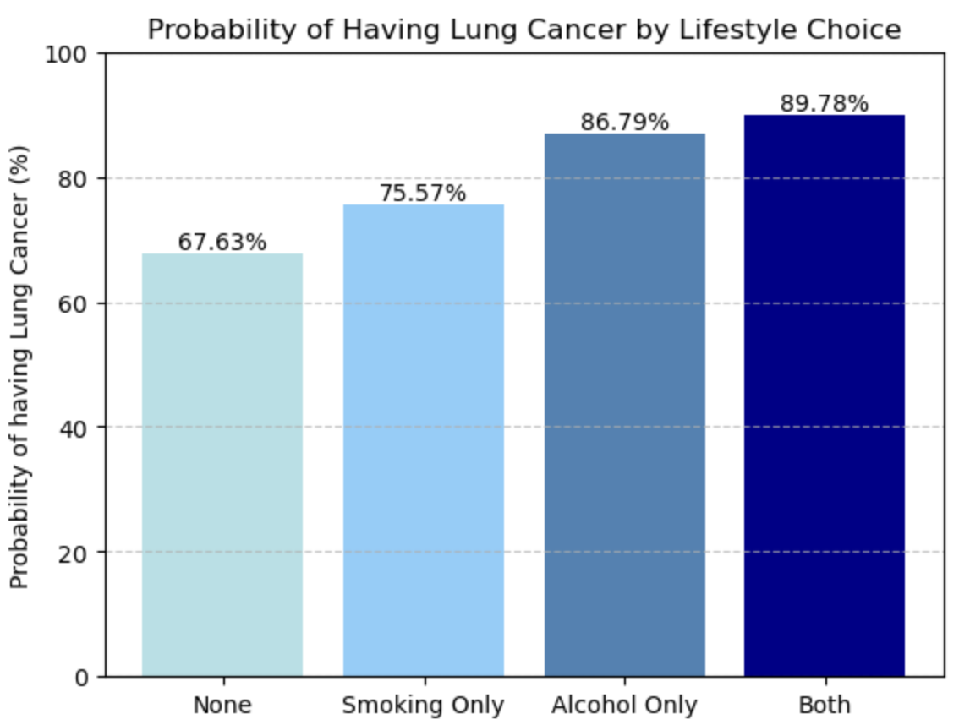
Lifestyle choices have an impact on lung cancer risk
Smoking
Leading cause of lung cancer
Accounts for almost 85% of cases globally
Contains cancer-causing chemicals (carcinogens)
Second-hand smoke can increase a non-smoker's risk by 20-30%
Consuming Alcohol
Causes damage to cells
Changes hormone levels which increases the chance of developing cancer
Introduction | Key Determinants | Machine Learning | Prevention Methods | Conclusion
Notes:
Our lifestyle choices have a major impact on lung cancer risk, particularly if one smokes or consumes alcohol. Smoking is the leading cause of lung cancer and accounts for almost 85% of cases globally. Even breathing in second-hand smoke can increase a non-smokers risk by 20-30%. Consuming excessive alcohol can cause damage to cells, as well as change hormone levels which increases the chance of developing lung cancer.
We found that the probability of developing lung cancer increases when an individual smokes or consumes alcohol, and it is the highest at nearly 90% when the individual both smokes and consumes alcohol

Slide 10
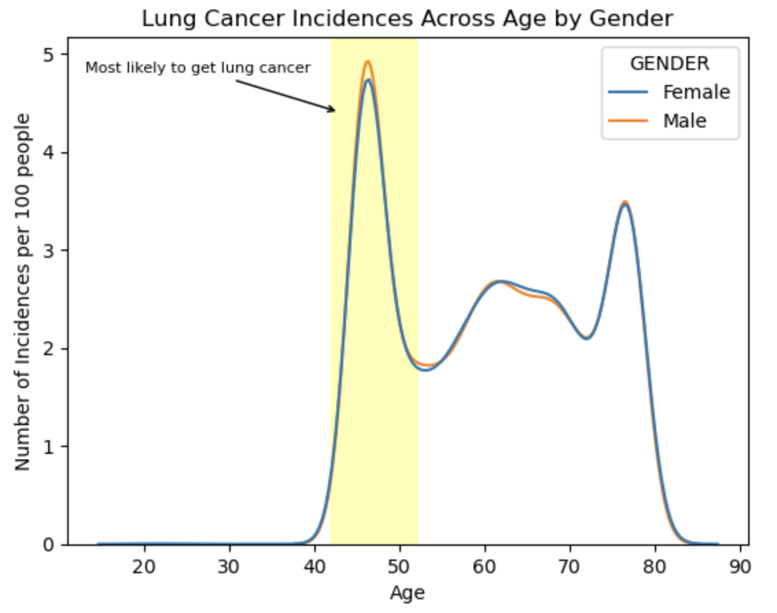
Age is a crucial factor when it comes to lung cancer
It has been shown that the chance of having cancer increases significantly with age as older individuals develop risks associated with cancer
Lung cancer is no exception as it is most commonly diagnosed in individuals above the age of 40
We see that in Singapore, within the working-age population, lung cancer is most prevalent
in people in their mid-40s to early 50s
Introduction | Key Determinants | Machine Learning | Prevention Methods | Conclusion
Notes:
Age is also a crucial factor where the chance of contracting cancer increases significantly with age as older individuals develop risks associated with cancer. Lung cancer is most commonly diagnosed in individuals above the age of 40, and in Singapore, it is most prevalent in individuals between their mid 40s to early 50s.

Slide 11



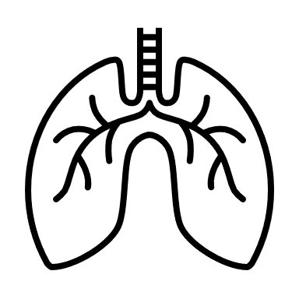



Common symptoms of lung cancer
Fatigue
Wheezing
Coughing
Shortness of Breath
Swallowing Difficulty
Chest Pain
Yellow Fingers
Introduction | Key Determinants | Machine Learning | Prevention Methods | Conclusion
Notes:
Moving on to the common symptoms of lung cancer we have fatigue, wheezing, coughing, shortness of breath, swallowing difficulty, chest pain and yellow fingers.
Next slide

Slide 12
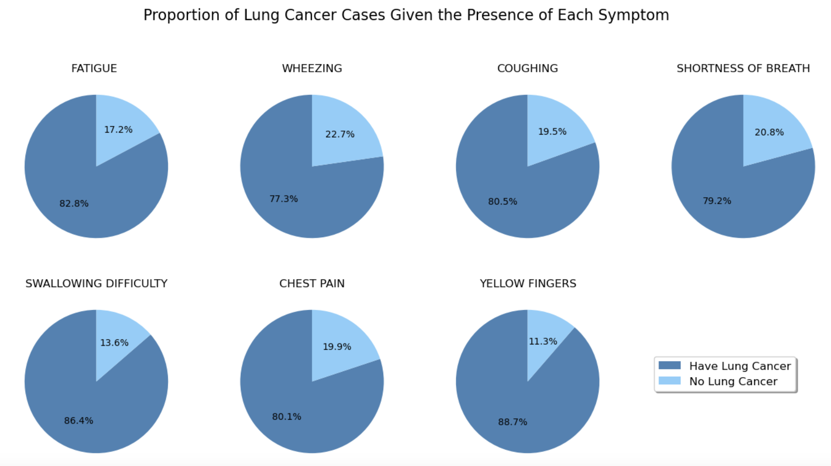
These symptoms are prevalent indicators
Among all the individuals with each symptom present, around 77% to 89% of the individuals had lung cancer depending on the symptom
Introduction | Key Determinants | Machine Learning | Prevention Methods | Conclusion
Notes:
Among all the individuals with each symptom present, around 77% to 89% of individuals had lung cancer depending on the symptom

Slide 13



We used 12 predictors in our predictive model
Predictors/Features
Target Variable
Age
(Numeric)
Alcohol Consuming
(Binary)
Smoking
(Binary)
Gender
(Binary)
Fatigue
(Binary)
Wheezing
(Binary)
Coughing
(Binary)
Shortness of Breath
(Binary)
Lung Cancer
(Binary)
Swallowing Difficulty
(Binary)
Chest Pain
(Binary)
Chronic Disease
(Binary)
Yellow Fingers
(Binary)
Introduction | Key Determinants | Machine Learning | Prevention Methods | Conclusion
Notes:
For our machine learning model, we utilized 12 predictors from the survey dataset as shown above
We decided to remove allergy and anxiety as we deemed them not to be relevant predictors
For most of the predictors, they are binary except age and our target variable is also binary
This means that we would utilize classification models as shown in the next slide

Slide 14

We explored different predictive models
Multivariable Logistic Regression:
Allows us to understand how each predictor increases the likelihood of lung cancer through the regression coefficients.
Decision Trees Classification:
Splits the dataset based on the most important factor and gives a combinations of predictors that are most associated with lung cancer.
Classification Models
K-Nearest Neighbour Classification:
Predicts likelihood of lung cancer based on their characteristics against those of (non-) cancer patients through the majority class of a feature.
Neural Networks:
Allows us to identify complex patterns to predict lung cancer occurrence through permutations in neural architecture.
Introduction | Key Determinants | Machine Learning | Prevention Methods | Conclusion
Notes:
We dedcied to use 4 types:
Firstly, it would be multivariate logistic regression Allows us to understand how each predictor increases the likelihood of lung cancer through the regression coefficients
We used decision trees as it splits the data based on the most important feature and it gives us gives a combinations of predictors that are most associated with lung cancer.
We used K Nearest Neighbour or KNN as its predicts likelihood of lung cancer based on their characteristics against those of (non-) cancer patients through the majority class of a feature
We used KNN as it allows us to identify complex patterns to predict lung cancer occurrence through permutations in neural architecture

Slide 15



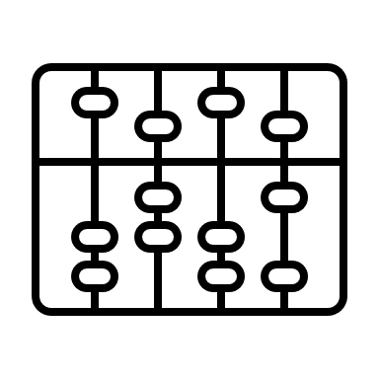
Model evaluation methodology
70%
30%
Training Set
Validation Set
4. Gather test error
for each model
All columns
Predictor
Columns
Target Variable
Column
1. Fit our model with the entire training set
2. Make predictions on validation set predictor
3. Compare predictions and actual value
5. Gather test error
for each model
To evaluate all our predictive models, we are utilizing the same validation-training split from
the original survey dataset to have a fair comparison of the predictive power of each model.
Introduction | Key Determinants | Machine Learning | Prevention Methods | Conclusion
Notes:
To evaluate our models, we utilized validation where we separated our data into a training set and validation set
We trained the model, generated prediction and compared the precdiction to get the test error for each model and compare them to find the optimal value
Hence by using the same validation_training split, we have a fair comparison of the predictive power of each model

Slide 16

We took steps to optimize our models
Multivariable Logistic Regression:
Regularization techniques (Ridge, Lasso, Elastic Net) and hyperparameter tuning on training set
Decision Trees Classification:
Utilized pre-pruning, cost-complexity pruning, and ensemble methods (bagging and random forest).
Model Optimization
K-Nearest Neighbours Classification:
Conducted hyperparameter turning on the training set to find the optimal value of K.
Neural Networks:
Experimented with the neural network architecture and with different activation functions
Introduction | Key Determinants | Machine Learning | Prevention & Treatment | Conclusion
Notes:
During the training process, there could be overfitting so we optimized our models
For our logistic regression we used Regularization techniques (Ridge, Lasso, Elastic Net) and hyperparameter tuning on training set
For decision trees, we utilisezed pre puring
For KNN, we conducted hyperparameter tuning to find the optimal K value
For Nueral Networks, we expereimneted with the arhcicture and different activation functions

Slide 17
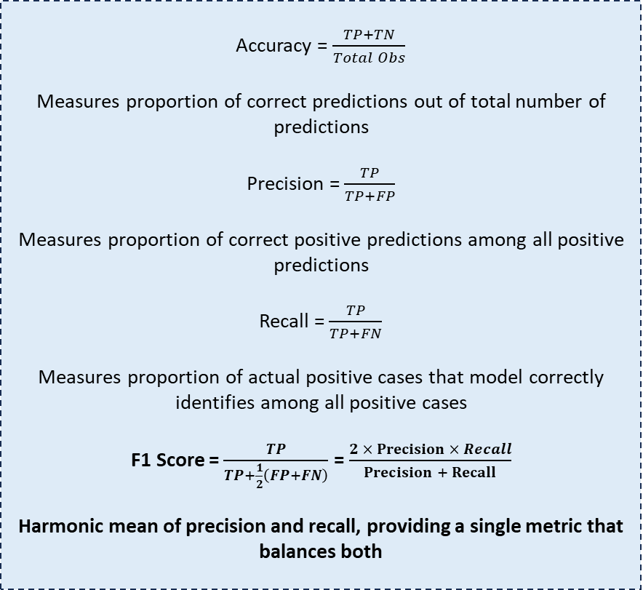
We chose F1-Score as our evaluation metric
Accuracy = $\frac{TP+TN}{Total Obs}$
Measures proportion of correct predictions out of total number of predictions
Precision = $\frac{TP}{TP+FP}$
Measures proportion of correct positive predictions among all positive predictions
Recall = $\frac{TP}{TP+FN}$
Measures proportion of actual positive cases that model correctly identifies among all positive cases
F1 Score = $\frac{TP}{TP+\frac{1}{2}\left(FP+FN\right)}$ = $\frac{2 × Precision × Recall}{Precision + Recall}$
Harmonic mean of precision and recall, providing a single metric that balances both
F1-score considers both types of misclassification (false positives and false negatives) unlike
accuracy, precision, and recall.
Disease identification requires greater stringency and false results are critical errors.
The F1-score also balances precision and
recall to avoid the risks of over-predicting
and under-predicting cancer.
Introduction | Key Determinants | Machine Learning | Prevention Methods | Conclusion
Notes:
We chose to use F1 score as out mertic to evaluatre models
There are different metrics available for us to use but only f1-score considers both

Slide 18
Our results from model evaluation
Model | F1-score on validation set
Mutli-logistic Regression | 0.9160599571734475
Lasso Regression | 0.9160599571734475
Ridge Regression | 0.9163278407875026
Elastic Net Regression | 0.9163636363636364
Decision Tree | 0.8882486108252726
Pruned Decision Tree | 0.91046712802768117
Bagging | 0.900972590627763
Random Forest | 0.900972590627763
K-Nearest Neighbour | 0.913915857605178
Neural Networks | 0.9147962519067335
Feature/Predictor
Coefficient
1.488284
Alcohol
Consuming
1.325378
Yellow
Fingers
0.714368
Swallowing Difficulty
0.509596
Fatigue
0.380304
Smoking
Introduction | Key Determinants | Machine Learning | Prevention Methods | Conclusion
Notes:
From our comparison we found that our elastic net regression modle was the one with the highest f1 score
From it we got the 5 top predictors based on their regression coefficients and we can once again see smoking and alcohol
We also see previously identified symptoms
Now I will hand my time to Kareem to talk more about how we can prevent lung cancer

Slide 19
Early detection is crucial for lung cancer
More than 60% of Lung Cancer Diagnosis are discovered at Stage 4 for males and females.
Introduction | Key Determinants | Machine Learning Model | Prevention Methods | Conclusion
Notes:
So in light of this information, what do we do? How can we minimise our risk of lung cancer? First of all, early detection is crucial. A majority of lung cancer cases were only discovered at stage 4. Early prevention and early screenings will help to minimise the risk of lung cancer as survival rates are significantly higher early. So frequent screening is helpful.

Slide 20

Avenues to help quit smoking
I Quit Programme
Almost 50% of people who smoke were peer pressured.
Introduction | Key Determinants | Machine Learning | Prevention Methods | Conclusion
Notes:
On top of Early Detection, early prevention is also key. In preventing lung cancer, not smoking is one of the best ways. We found that 50% of smokers smoke due to peer pressure. Not falling for this would be ideal in preventing the habit of smoking. However, if you have fallen for that trap, there are avenues like the I Quit Programem that provide a personalised 28 day programme that helps you to stop the habit.

Slide 21


Avenues to help in curbing alcohol consumption
Introduction | Key Determinants | Machine Learning | Prevention Methods | Conclusion
Notes:
Likewise, we all mentioned alcohol consumption as a key predictor. if you are facing issues with drinking and/or afflicted of being an alcholic, we recommend services like the national addictionns management service or the we care community services that provide avenues to curb alcohol consumption.

Slide 22
Conclusion
Lung cancer: a growing concern
Ranked in the top 3 cancers affecting both genders, with the highest mortality rate in males.
Lung cancer cases are rising, with an expected increase in future years.
Insights from our predictive model analysis
Smoking and Drinking: Both are significant predictors of lung cancer and increase the probability of developing lung cancer drastically - combining both behaviors amplifies the risk even further. This is supported by our earlier secondary research.
Yellow Fingers, Swallowing Difficulties and Fatigue: These symptoms, more so than others, can signal the progression of lung cancer, emphasizing the importance of early symptom awareness for timely intervention.
Through early intervention, we can help reduce lung cancer occurrence.
Early detection and prevention save lives
Most diagnoses occur in the late stages, highlighting the need for greater awareness.
Advancements in treatment are improving survival rates, but early detection remains critical for better outcomes.
Introduction | Key Determinants | Machine Learning | Prevention Methods | Conclusion

Slide 23
Thank You!
Group 5: Abdullah, Adrian, Firas, Mattia, Kareem

